Slide 1


Pannagram
pan--genome:
annotations,
an-alysis &
diagrams
Anna Igolkina
14.12.23

Slide 2
bash - R

Slide 3
Pipeline for Multiple Genome Alignment
Two possibilities:
pangen_ref: align to one reference genome
pangen_consensus: align to several reference genomes, reference-free
Step 1. Genomes into chromosomes
Step 2. Chromosomes into parts
Step 3. BLAST of parts against the reference genome
Step 4. Alignment-1. Remaining syntenic (major) matches
Step 5. BLAST of gaps between syntenic matches
Step 6. Alignment-2. Fill the gaps between synteny blocks
Step 7. Combine reference-based alignments by chromosomes
Step 8. Randomisation of alignments. Combine two references: XXX and YYY
Step 9. Find Positions of Common Gaps in the Reference-Free Multiple Genome Alignment
Step 10. Prepare sequences for MAFFT
Step 11. Run MAFFT
Step 12. Combine all alignments together into the final one
Notes:
./pangen_ref.sh -pref_global ../pan_test/ly_th/ -ref_pref 0 -path_chr_ref ../pan_test/p27/chromosomes/ -n_chr_ref 5 -path_in ../lyrata/ -n_chr_query 8 -all_cmp T -cores 30

Slide 4
Pipeline for Multiple Genome Alignment
Two possibilities:
pangen_ref: align to one reference genome
pangen_consensus: align to several reference genomes, reference-free
Step 1. Genomes into chromosomes
Step 2. Chromosomes into parts
Step 3. BLAST of parts against the reference genome
Step 4. Alignment-1. Remaining syntenic (major) matches
Step 5. BLAST of gaps between syntenic matches
Step 6. Alignment-2. Fill the gaps between synteny blocks
Step 7. Combine reference-based alignments by chromosomes
Step 8. Randomisation of alignments. Combine two references: XXX and YYY
Step 9. Find Positions of Common Gaps in the Reference-Free Multiple Genome Alignment
Step 10. Prepare sequences for MAFFT
Step 11. Run MAFFT
Step 12. Combine all alignments together into the final one
Notes:
./pangen_ref.sh -pref_global ../pan_test/ly_th/ -ref_pref 0 -path_chr_ref ../pan_test/p27/chromosomes/ -n_chr_ref 5 -path_in ../lyrata/ -n_chr_query 8 -all_cmp T -cores 30

Slide 5
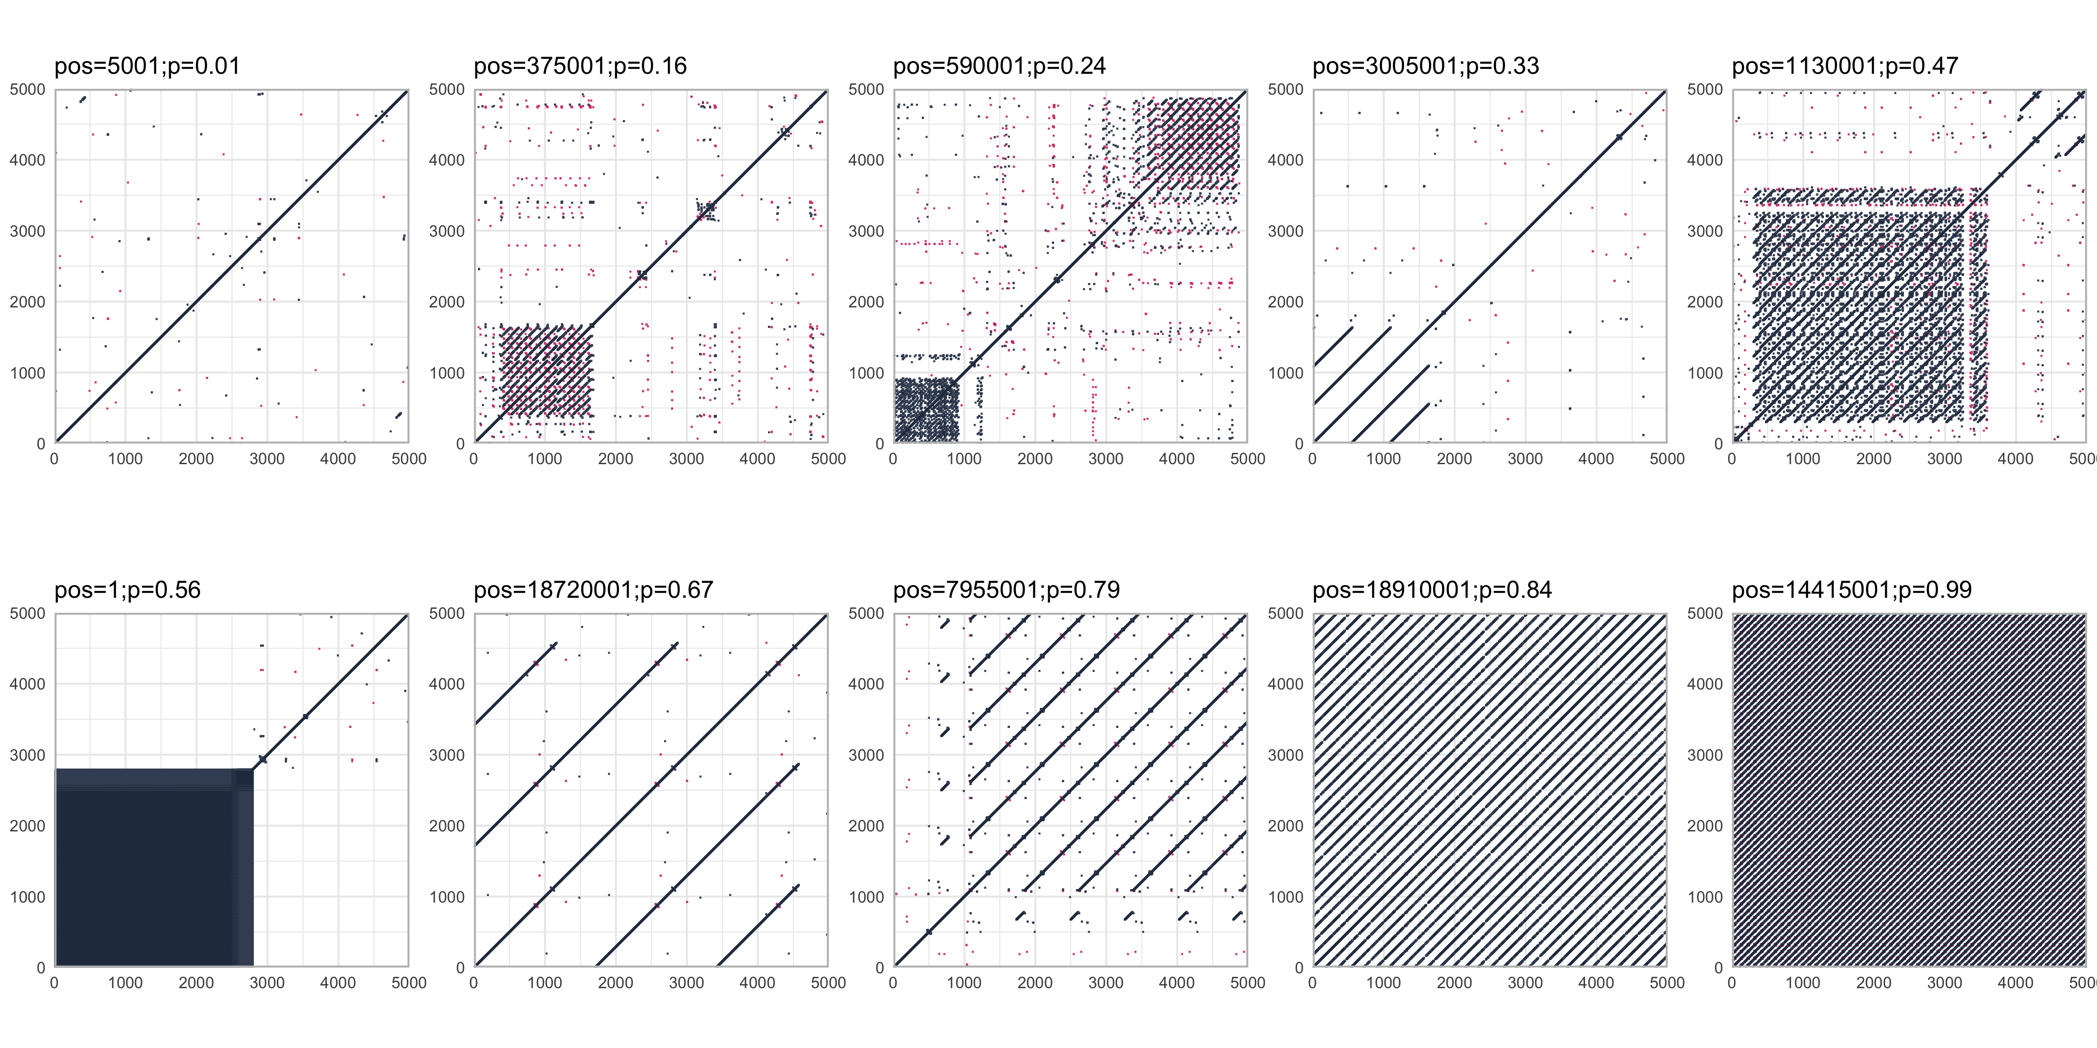
Complexity score
The proportion of k-mers that occur >= 3 times
+dotplot function

Slide 6
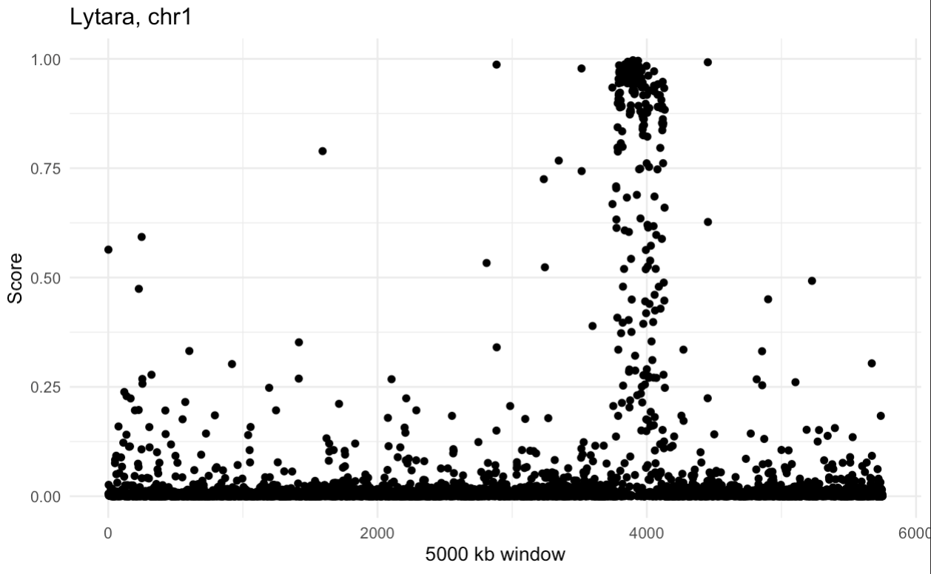
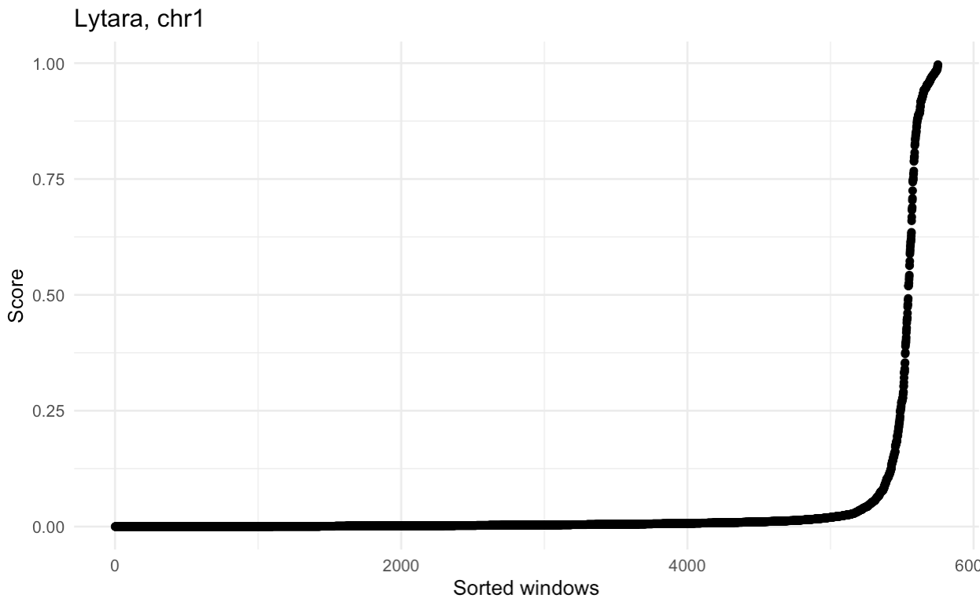
Complexity score
The proportion of k-mers that occur >= 3 times
k=11

Slide 7
Pipeline for Multiple Genome Alignment
Two possibilities:
pangen_ref: align to one reference genome
pangen_consensus: align to several reference genomes, reference-free
Step 1. Genomes into chromosomes
Step 2. Chromosomes into parts
Step 3. BLAST of parts against the reference genome
Step 4. Alignment-1. Remaining syntenic (major) matches
Step 5. BLAST of gaps between syntenic matches
Step 6. Alignment-2. Fill the gaps between synteny blocks
Step 7. Combine reference-based alignments by chromosomes
Step 8. Randomisation of alignments. Combine two references: XXX and YYY
Step 9. Find Positions of Common Gaps in the Reference-Free Multiple Genome Alignment
Step 10. Prepare sequences for MAFFT
Step 11. Run MAFFT
Step 12. Combine all alignments together into the final one
Notes:
./pangen_ref.sh -pref_global ../pan_test/ly_th/ -ref_pref 0 -path_chr_ref ../pan_test/p27/chromosomes/ -n_chr_ref 5 -path_in ../lyrata/ -n_chr_query 8 -all_cmp T -cores 30

Slide 8
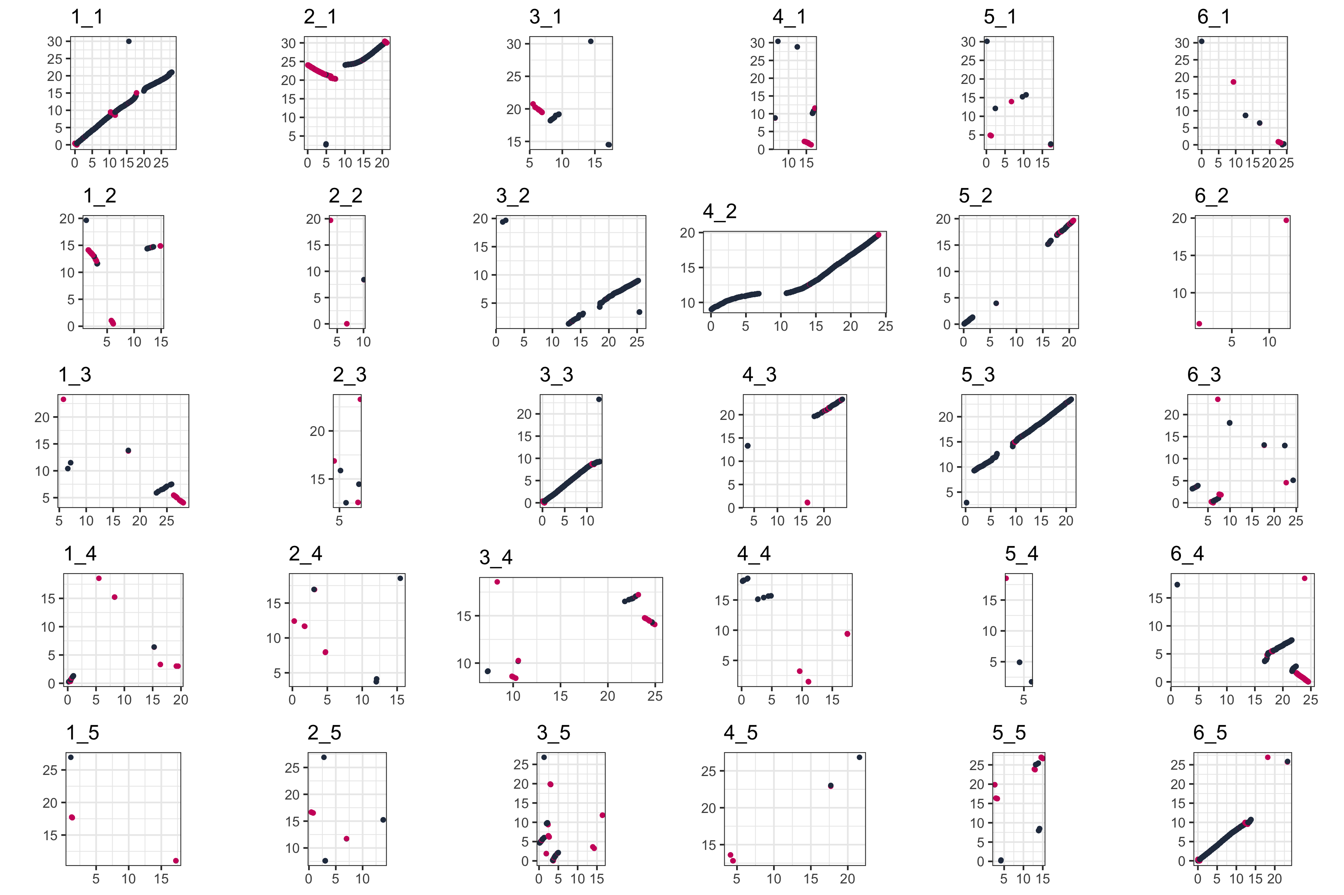
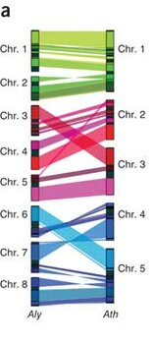
Major synteny
between query genome and one reference genome

Slide 9
Pipeline for Multiple Genome Alignment
Two possibilities:
pangen_ref: align to one reference genome
pangen_consensus: align to several reference genomes, reference-free
Step 1. Genomes into chromosomes
Step 2. Chromosomes into parts
Step 3. BLAST of parts against the reference genome
Step 4. Alignment-1. Remaining syntenic (major) matches
Step 5. BLAST of gaps between syntenic matches
Step 6. Alignment-2. Fill the gaps between synteny blocks
Step 7. Combine reference-based alignments by chromosomes
Step 8. Randomisation of alignments. Combine two references: XXX and YYY
Step 9. Find Positions of Common Gaps in the Reference-Free Multiple Genome Alignment
Step 10. Prepare sequences for MAFFT
Step 11. Run MAFFT
Step 12. Combine all alignments together into the final one
Notes:
./pangen_ref.sh -pref_global ../pan_test/ly_th/ -ref_pref 0 -path_chr_ref ../pan_test/p27/chromosomes/ -n_chr_ref 5 -path_in ../lyrata/ -n_chr_query 8 -all_cmp T -cores 30

Slide 10
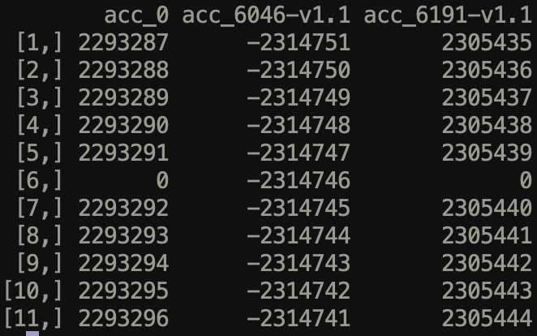
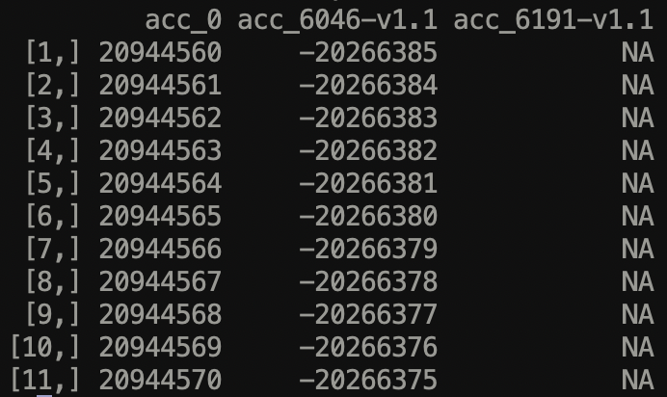
analys.sh –blocks
Get synteny blocks.
Also inserts NAs fot those positions which were not aligned

Slide 11
Correspondence between accessions
Chromosome 4
Chromosome 5

Slide 12
analys.sh -seq
Consensus sequence, and distribution of ACGT- per each pangenome position
-snp (in progress)
What is the SNPS?

Slide 13
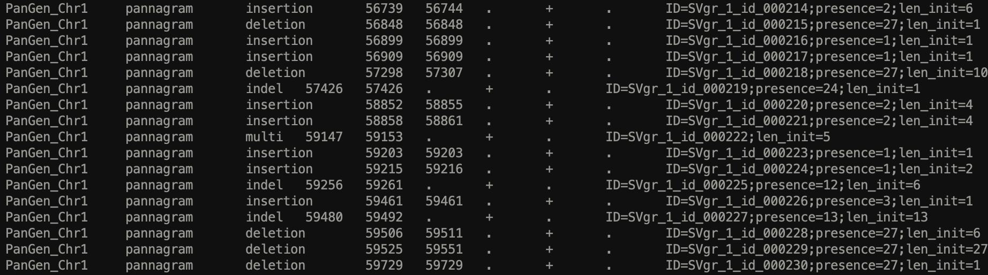
SV
sv.sh
-gff : annotation in pangenome coordinates and separate accessions
-te -te_file : similarity to a set of sequence
-graph : construction the graph of nestedness
types: multi/insertion/deletion/indel
Sequences only for non-multi

Slide 14
Graph of Nestedness + Enrichment analysis
(in progress)

Slide 15
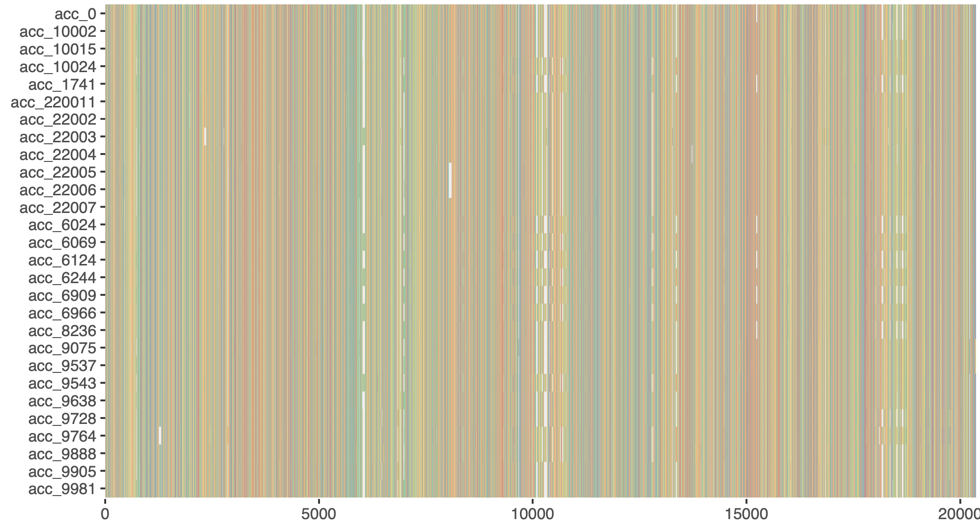
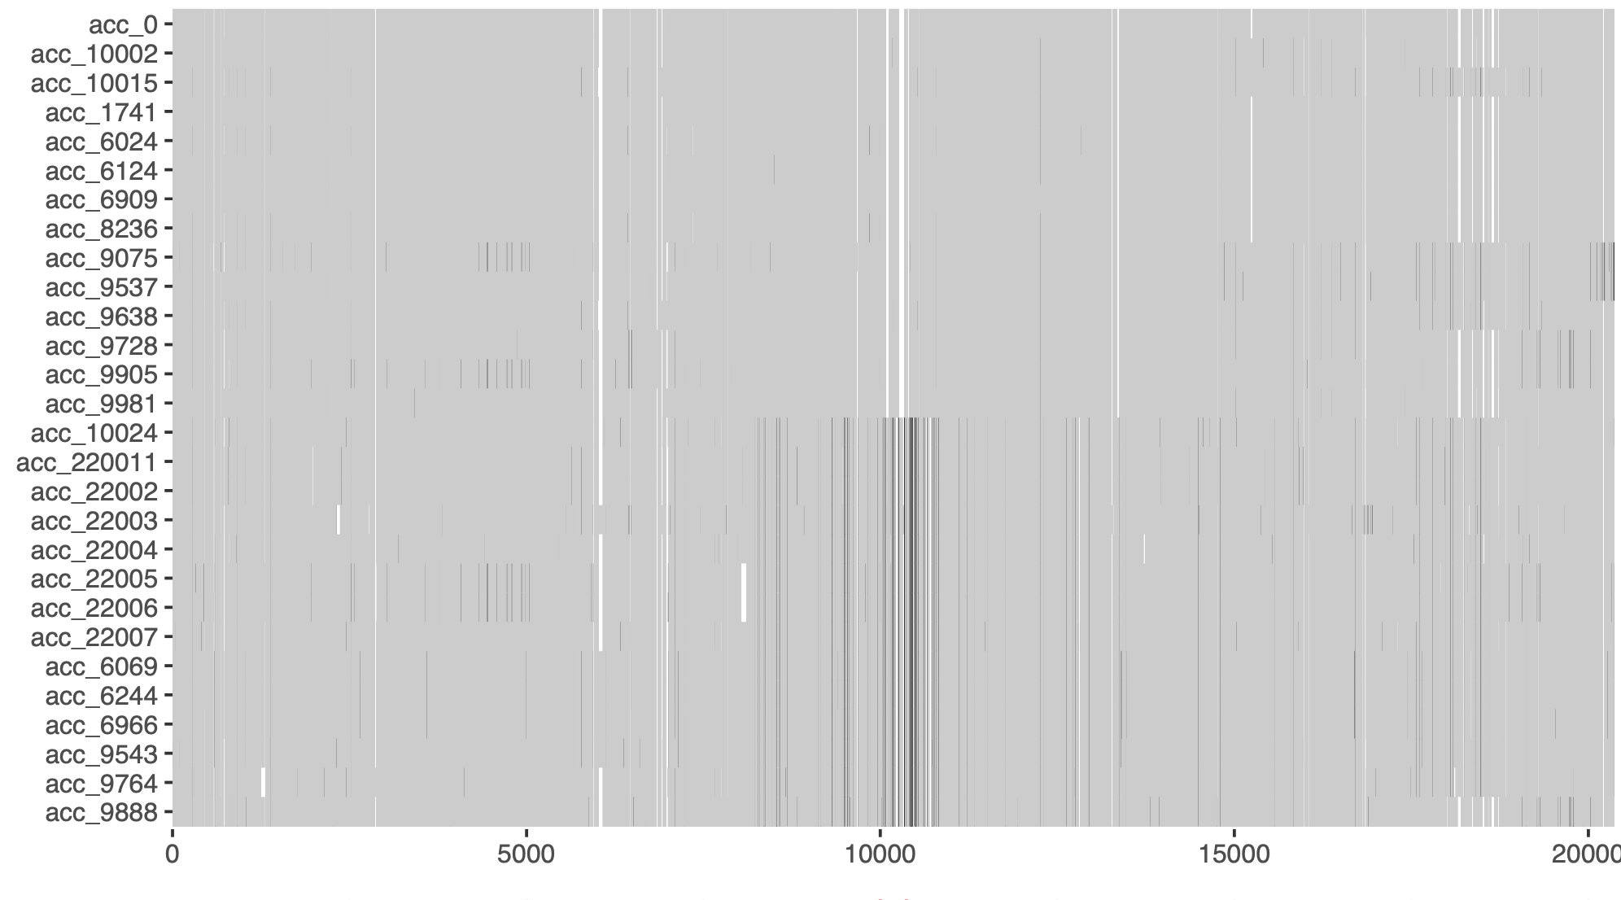
Visualisation
Multiple Sequence Alignment

Slide 16
Search for sequences
in a genome
in another set of sequences
with a specific similarity threshold

Slide 17
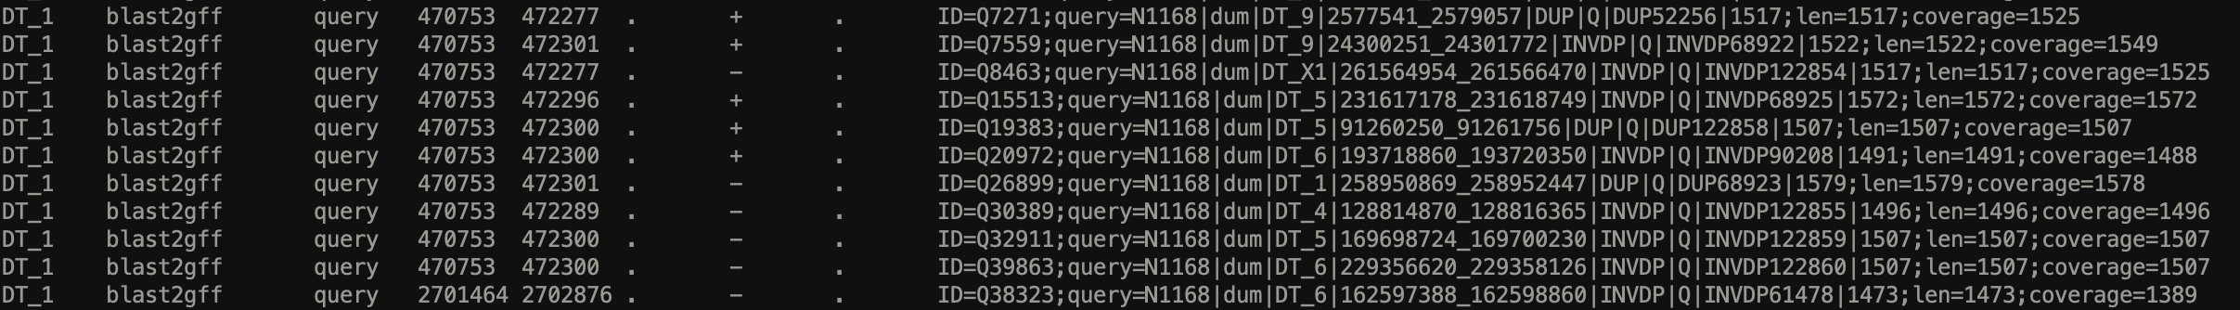
Search for sequences
in a genome
+ gff2seq

Slide 18
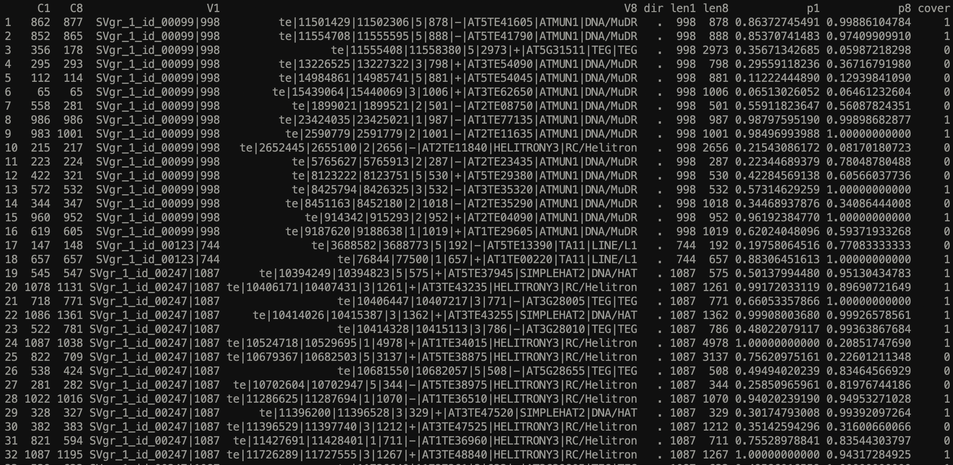
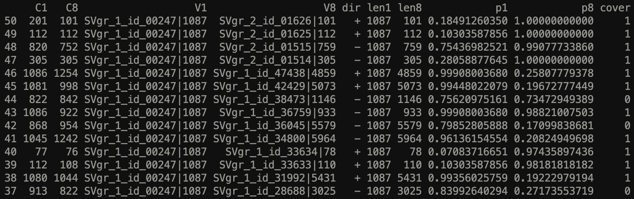
Search for sequences
in another set of sequences (with or without direction)
+ ORF-finder

Slide 19
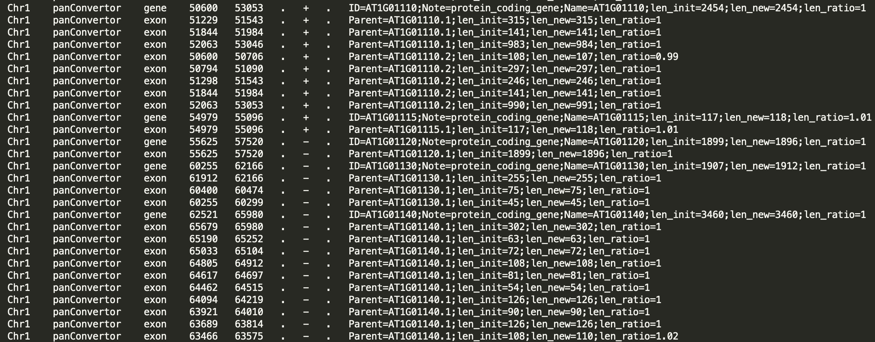
Annotation
Annotatate one genome by the annotation in another genome
Annotation groups (in progress)

